Slide 1
7.2 Exponential Change and
Separable Differential Equations
Exponential Change
In modeling many real-world situations, a quantity y increases or decreases at a rate proportional to its size at a given time t. Examples of such quantities include the amount of a decaying radioactive material, the size of a population, and the
temperature difference between a hot object and its
surrounding medium. Such quantities are said to undergo
exponential change

Slide 2
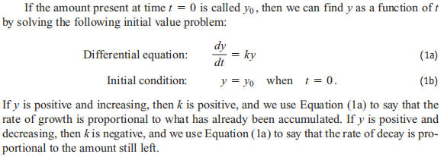

Slide 3
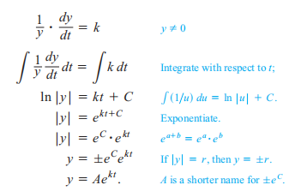
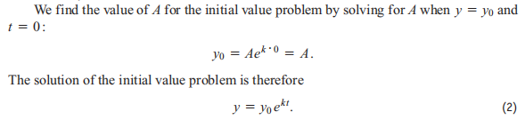

Slide 4

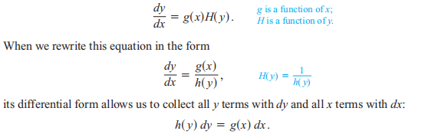
Separable Differential Equations
Now we will discuss the first order differential equation:
The ODE is separable if ƒ can be expressed as a product of a function of x and a function of y. The differential equation then has the form

Slide 5
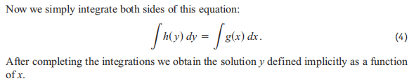
The above solution is called the implicit solution.
Sometimes we can find the explicit solution y of x, then this solution is called the explicit solution.

Slide 6
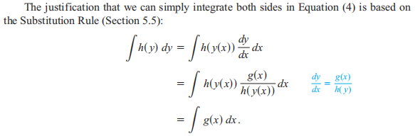

Slide 7
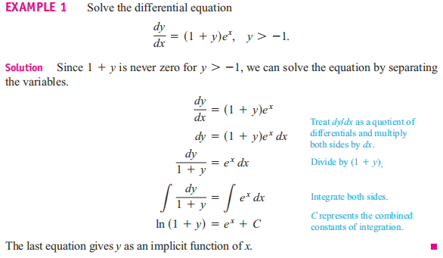

Slide 8
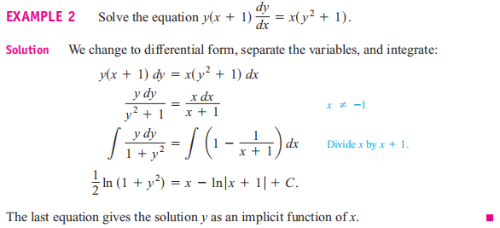

Slide 9
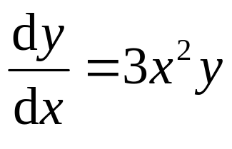
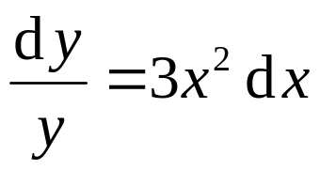
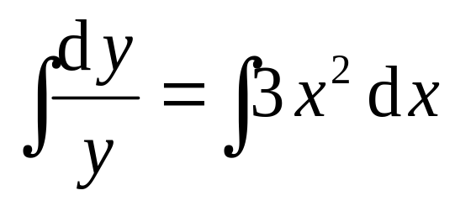
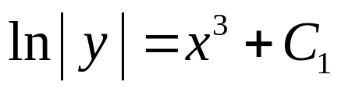
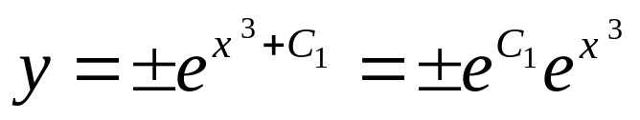
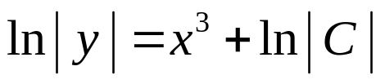

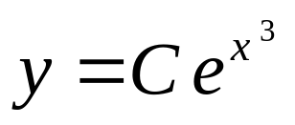
Example 3. Find the general solution of the following ODE
Solution: Separate the variables
Missing the solution y=0
Integrate both sides
then
or
that is
( C is arbitrary )
( Now we retrieve the missing solution y = 0 )

Slide 10
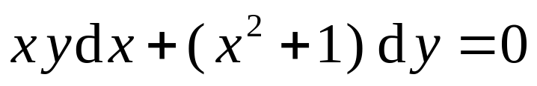
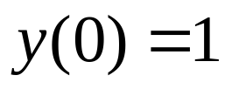
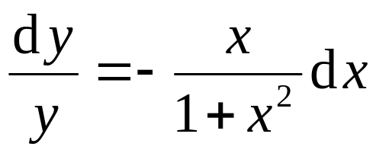
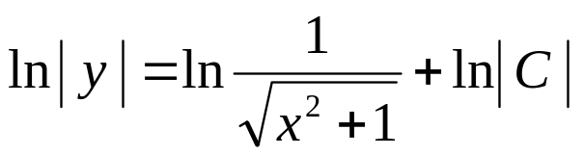
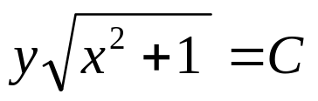
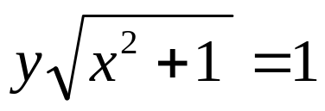
Example 4. Solve the initial value problem:
Solution: Separate the variables
Integrate both sides
that is
( C is arbitrary )
then the particular solution is
From the intial value, we find C = 1,

Slide 11
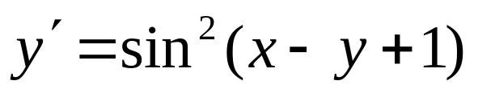
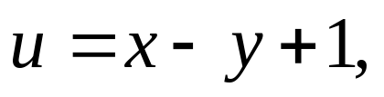

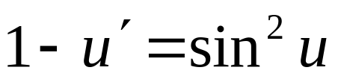
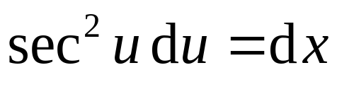

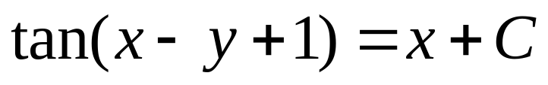
Example 5. Find the general solution of the
following ODE:
Solution: Let
then
and
That is
Integrate both sides, we find
Therefore, the implicit general solution is:
( C is arbitrary )

Slide 12
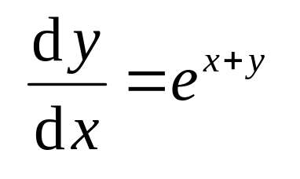
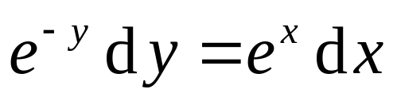

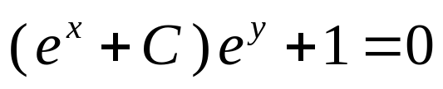
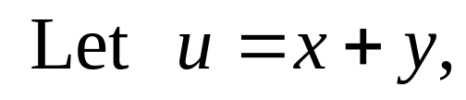


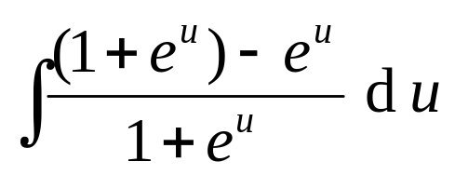
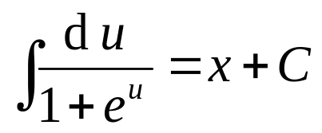
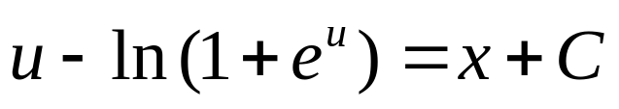
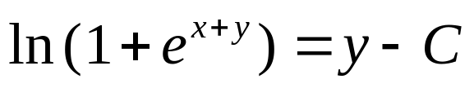
Example 5. Find the general solution of the
following ODE:
Solution: 1.Separate the variables
That is
( C < 0 )
2
and
Therefore, the general solution is:

